Slide 1
Convolutional Neural Networks
CSCI 4150/6050: Computer Vision
Many of the slides are from
Professor David Wingate (BYU)

Slide 2
The Three Pieces of Deep Learning
Labeled Data
  Do I have enough ground truth labels and images?
A Neural Network
  What mathematical operations am I performing on the images?
A Loss Function
  How does the network know when it is doing well?

Slide 3

Let’s look at an example

Slide 4
Warning: Dimension Order
So far, we have treated image data as [rows, columns, channels] ie 256x256x3
In PyTorch, the default is to load images as [batch, channels, rows, columns] ie 8, 3, 256, 256
This is important for when you are building dataloaders and debugging.

Slide 5
The Three Pieces of Deep Learning
Labeled Data
  Do I have enough ground truth labels and images?
A Neural Network
  What mathematical operations am I performing on the images?
A Loss Function
  How does the network know when it is doing well?

Slide 6
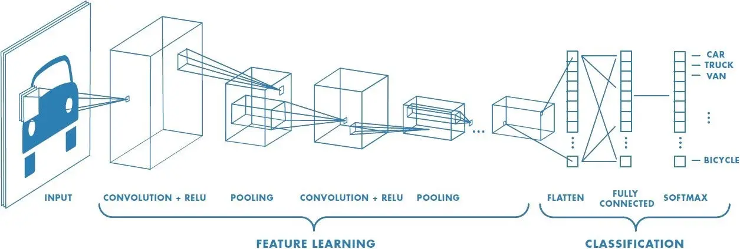
Convolutional Neural Networks (CNN)
Use standard convolution as your feature extractor, but let the neural networks learn the weights.
Learn the classification targets at the same time you learn the weights.
Image Credit: Sumit Saha

Slide 7
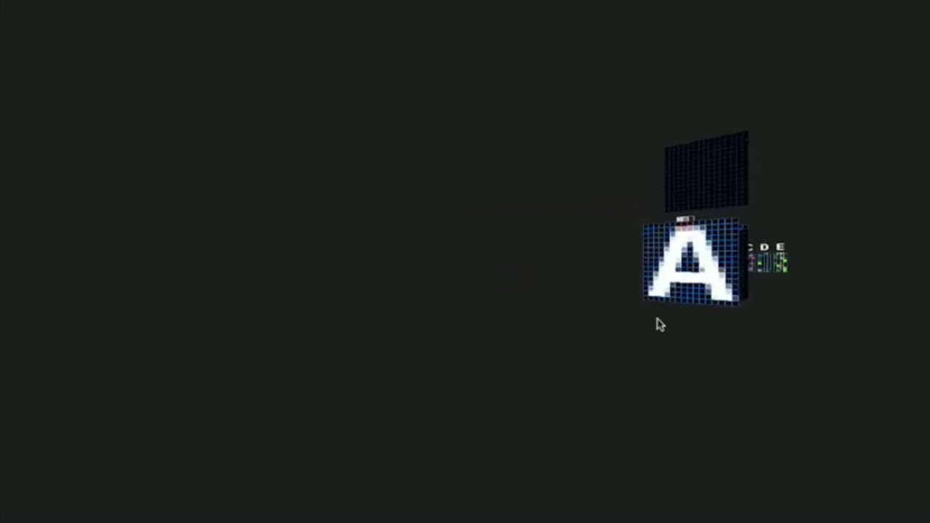

Slide 8
How do you design an effective convolutional neural network?

Slide 9
The pieces of a CNN
Convolution
  What should the features be? Ie edges etc
Activation Function (non-linear)
  How do I filter out irrelevant features?
Pooling
  How do I analyze features at different scales?
Linear Layers
  How do I classify based on the features I have?

Slide 10
The pieces of a CNN
Convolution
  What should the features be?
Activation Function
  How do I filter out irrelevant features?
Pooling
  How do I analyze features at different scales?
Linear Layers
  How do I classify based on the features I have?

Slide 11
Convolution Layer
32x32x3 image
32
height
32
width
3
depth

Slide 12
Convolution Layer
32x32x3 image
5x5x3 filter
32
Convolve the filter with the image
i.e. “slide over the image spatially, computing dot products”
32
3

Slide 13
Convolution Layer
Filters always extend the full depth of the input volume as it has to operate across all channels simultaneously.
32x32x3 image
5x5x3 filter
32
Convolve the filter with the image
i.e. “slide over the image spatially, computing dot products”
32
3

Slide 14
Convolution Layer
activation map
32x32x3 image
5x5x3 filter
32
28
convolve (slide) over all spatial locations
32
28
3
1

Slide 15
consider a second, green filter
Convolution Layer
32x32x3 image
5x5x3 filter
activation maps
32
28
convolve (slide) over all spatial locations
32
28
3
1
Activation map is smaller because there is no padding.

Slide 16
For example, if we had 6 5x5 filters, we’ll get 6 separate activation maps:
activation maps
32
28
Convolution Layer
32
28
3
6
We stack these up to get a “new image” of size 28x28x6!

Slide 17
Preview: ConvNet is a sequence of Convolutional Layers, interspersed with activation functions
32
28
24
….
CONV,
ReLU
e.g. 6 5x5x3 filters
CONV,
ReLU
e.g. 10 5x5x6 filters
CONV,
ReLU
32
28
24
3
6
10
Learn features on original image, then because of no padding, it becomes 28x28 with different features which you learn on again tilll the deepest level.

Slide 18
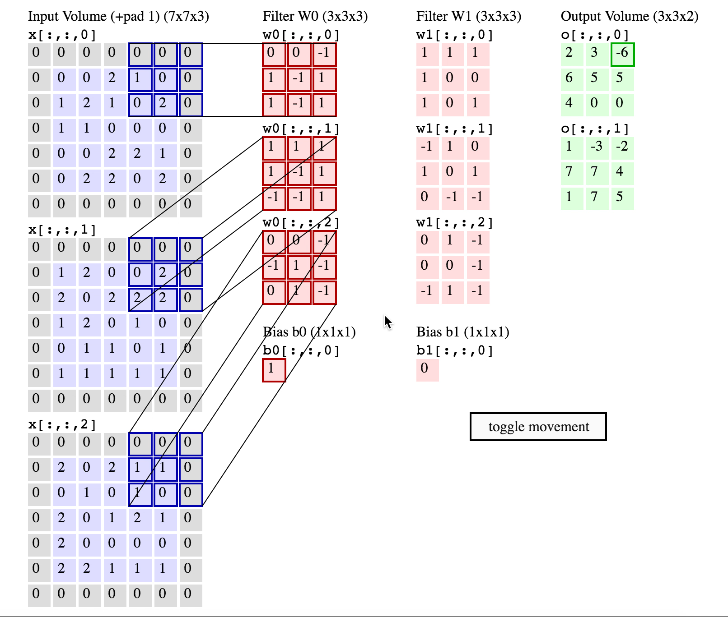

Slide 19
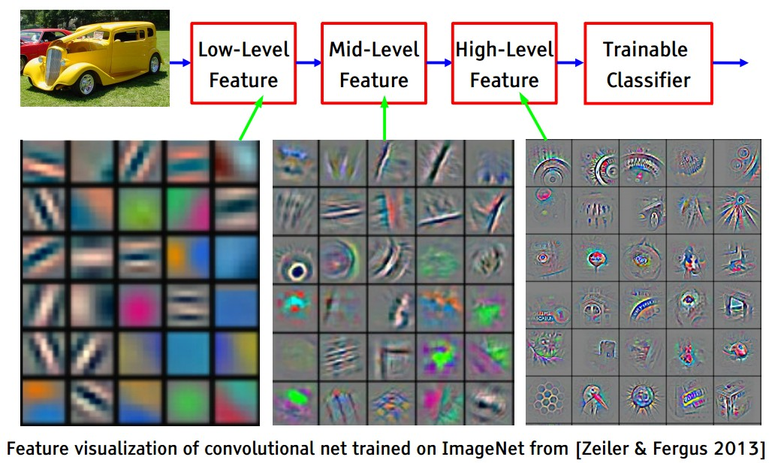
Preview
[From recent Yann LeCun slides]
By learning on the convolution of a previous conv you build a bigger picture idea by connecting points, etc.

Slide 20
Remember back to…
E.g. 32x32 input convolved repeatedly with 5x5 filters shrinks volumes spatially!
(32 -> 28 -> 24 ...). Shrinking too fast is not good, doesn’t work well.
32
28
24
….
CONV,
ReLU
e.g. 6 5x5x3 filters
CONV,
ReLU
e.g. 10 5x5x6 filters
CONV,
ReLU
32
28
24
3
6
10

Slide 21
A closer look at spatial dimensions:
activation map
32x32x3 image
5x5x3 filter
32
28
convolve (slide) over all spatial locations
32
28
3
1

Slide 22
A closer look at spatial dimensions:
7
7x7 input (spatially)
assume 3x3 filter
7

Slide 23
A closer look at spatial dimensions:
7
7x7 input (spatially)
assume 3x3 filter
7

Slide 24
A closer look at spatial dimensions:
7
7x7 input (spatially)
assume 3x3 filter
7

Slide 25
A closer look at spatial dimensions:
7
7x7 input (spatially)
assume 3x3 filter
7

Slide 26
A closer look at spatial dimensions:
7
7x7 input (spatially)
assume 3x3 filter
=> 5x5 output
7

Slide 27
In practice: Common to zero pad the border
0 | 0 | 0 | 0 | 0 | 0
0
0
0
0
e.g. input 7x7
3x3 filter, applied with stride 1
pad with 1 pixel border => what is the output?

Slide 28
In practice: Common to zero pad the border
0 | 0 | 0 | 0 | 0 | 0
0
0
0
0
e.g. input 7x7
3x3 filter, applied with stride 1
pad with 1 pixel border => what is the output?
7x7 output!

Slide 29
In practice: Common to zero pad the border
0 | 0 | 0 | 0 | 0 | 0
0
0
0
0
e.g. input 7x7
3x3 filter, applied with stride 1
pad with 1 pixel border => what is the output?
7x7 output!
in general, common to see CONV layers with and zero-padding to preserve size spatially
e.g. 3x3 => zero pad with 1
5x5 => zero pad with 2
7x7 => zero pad with 3

Slide 30
Other Considerations - Stride:
7
7x7 input (spatially)
assume 3x3 filter
applied with stride 2
7

Slide 31
Other Considerations - Stride :
7
7x7 input (spatially)
assume 3x3 filter
applied with stride 2
7

Slide 32
Other Considerations - Stride:
7
7x7 input (spatially)
assume 3x3 filter
applied with stride 2
=> 3x3 output!
7

Slide 33
Other Considerations - Stride:
7
7x7 input (spatially)
assume 3x3 filter
applied with stride 3?
7

Slide 34
Other Considerations - Stride:
7
7x7 input (spatially)
assume 3x3 filter
applied with stride 3?
7

Slide 35
Other Considerations - Stride:
7
7x7 input (spatially)
assume 3x3 filter
applied with stride 3?
7
doesn’t fit!
cannot apply 3x3 filter on 7x7 input with stride 3.

Slide 36
N
Formula for Output Size:
(N + 2P - F) / stride + 1
N: Image Size
P: Padding Amount
F: Kernel Size
e.g. N = 7, F = 3, P=0:
stride 1 => (7 - 3)/1 + 1 = 5
stride 2 => (7 - 3)/2 + 1 = 3
stride 3 => (7 - 3)/3 + 1 = 2.33 :\
F
N
F

Slide 37
Examples time:
Input volume: 32x32x3
10 5x5 filters with stride 1, pad 2
Output volume size: ?

Slide 38
Examples time:
Input volume: 32x32x3
10 5x5 filters with stride 1, pad 2
Output volume size:
(32+2*2-5)/1+1 = 32 spatially, so
32x32x10

Slide 39
Examples time:
Input volume: 32x32x3
10 5x5 filters with stride 1, pad 2
Number of parameters in this layer?

Slide 40
Examples time:
Input volume: 32x32x3
10 5x5 filters with stride 1, pad 2
Number of parameters in this layer?
each filter has 5*5*3 + 1 = 76 params (+1 for bias)
76*10 = 760
Uses filter size 5x5

Slide 41
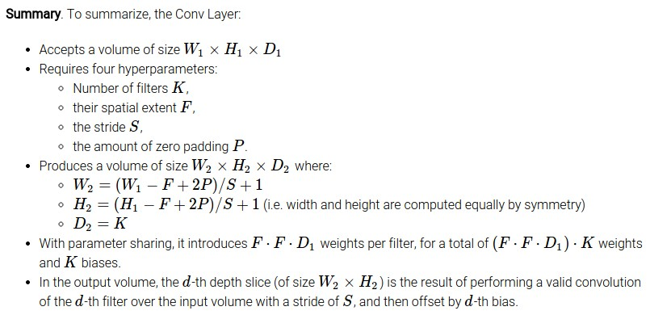

Slide 42
Common settings:
K = (powers of 2, e.g. 32, 64, 128, 512)
F = 3, S = 1, P = 1
F = 5, S = 1, P = 2
F = 5, S = 2, P = ? (whatever fits)
F = 1, S = 1, P = 0

Slide 43
The pieces of a CNN
Convolution
  What should the features be?
Activation Function
  How do I filter out irrelevant features?
Pooling
  How do I analyze features at different scales?
Linear Layers
  How do I classify based on the features I have?

Slide 44
Pooling Layer
32x32x3 image
2x2x3 filter
32
Move the filter over the image (without overlap) and aggregate the features with a function such as “mean” or “max”
32
3
Pooling is an aggregation operation that moves over the image and aggregate with functions like max. eg for 2 pixels, it can get the max, retain it and discard the other value thereby reducing the size
Of the image as well. Why?? To get to the higher level ideas, so they can identify tiny details, drop unecessary stuff and get the higher level ideas like an eye, face, etc.

Slide 45
Pooling Layer
activation map
32x32x3 image
2x2x3 filter
32
16
Slide over all spatial locations without overlap
16
3
32
3
Pooling is an effective way of analyzing the image at different spatial resolutions.

Slide 46
Let’s Try It in Pytorch!

